Slide 1
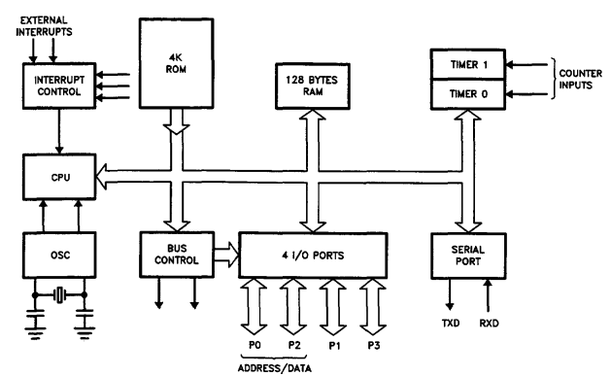
Architectural Overview
Chapter 2: Microcontroller MCS51
Block Diagram of µC8051

Slide 2
Architectural Overview
Chapter 2: Microcontroller MCS51
Feature 8031 8051 8052
ROM (bytes) NO 4k 8k
RAM (bytes) 128 128 256
Timers 2 2 3
I/O Pins 32 32 32
Serial port 1 1 1
Interrupt sources 6 6 8

Slide 3
Architectural Overview
Chapter 2: Microcontroller MCS51
External interrupts
4Kbytes
ROM
Timer/Counter
Interrupt Control
128 Bytes RAM
Timer 1
Timer 0
CPU
Bus Control
Serial Port
OSC
4 I/O Ports
P0 P2 P1 P3
TxD RxD
Address/Data

Slide 4
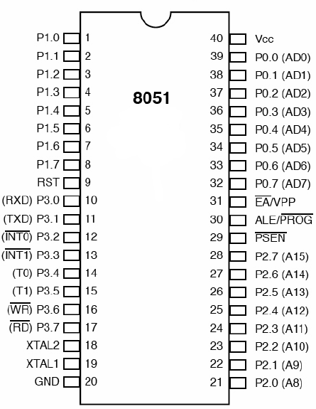
PIN
Chapter 2: Microcontroller MCS51
Including:
  40 pins

Slide 5
PIN
Chapter 2: Microcontroller MCS51
Port 0 (pin32 ÷ pin39):
  Data input/output pin
  8 Lower Address bits or Data bus
Port 1 (pin1 ÷ pin8):
  Data input/output pin
Port 2 (pin21 ÷ Pin28)
  Data input/output pin
  8 Higher Address bits
Port 3 (pin10 ÷ pin17):
  Data input/output pin
  Special functions

Slide 6
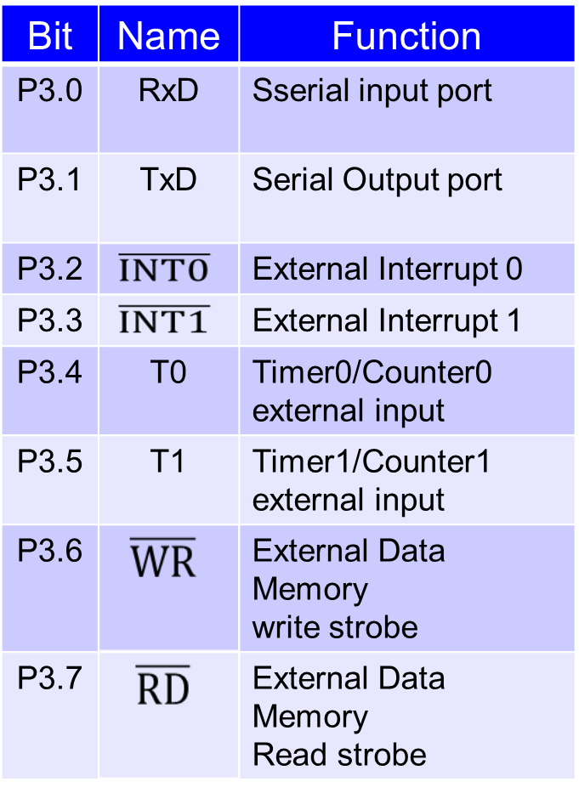
PIN
Chapter 2: Microcontroller MCS51

Slide 7
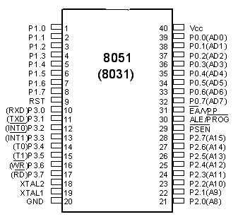
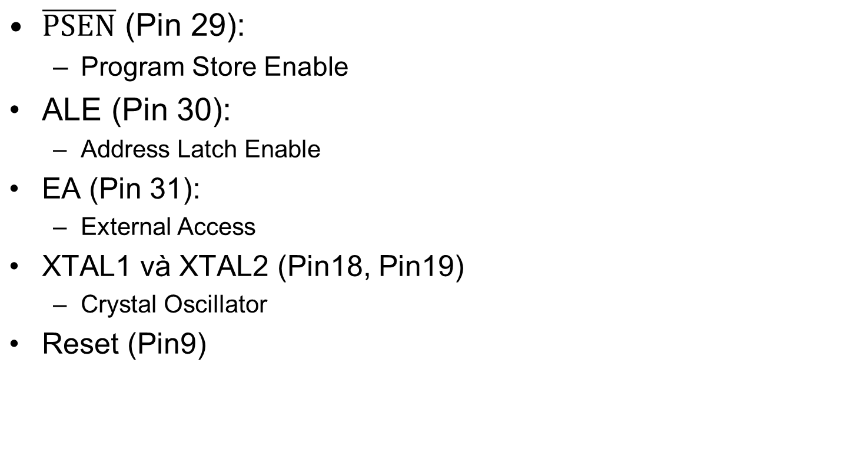
PIN
Chapter 2: Microcontroller MCS51

Slide 8
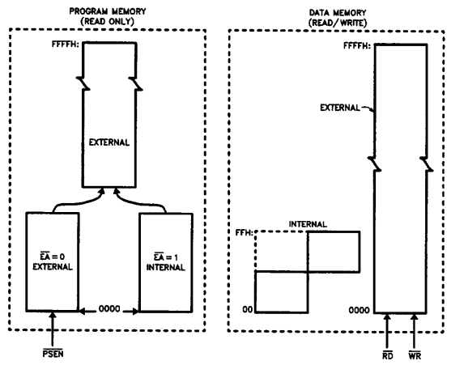
Memory Organization
Chapter 2: Microcontroller MCS51
Memory Structure:

Slide 9
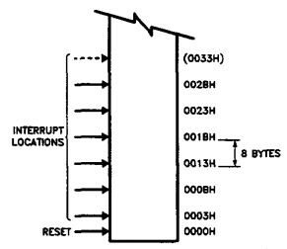
Memory Organization of 8051
Chapter 2: Microcontroller MCS51
Program Memory

Slide 10
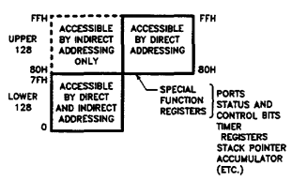
Memory Organization of 8051
Chapter 2: Microcontroller MCS51
Data Memory

Slide 11
Memory Organization of 8051
Chapter 2: Microcontroller MCS51
Data memory : 128 bytes of 8051 RAM
7FH
30H
2FH
7F
78
Bit – addressable space (128 bits)
20H
07
00
1FH
Register bank 3
18H
17H
Register bank 2
10H
0FH
Register bank 1 /
(Stack)
08H
07H
00H
Register bank 0

Slide 12
Memory Organization in 8051
Chapter 2: Microcontroller MCS51
Connect to external program and data memory:
  Extend to 64KB ROM and 64KB RAM
  Address bus: 16 bit, includes:
    AD0 – AD7 (Port 0): lower address/data bus
    A8 – A15 (Port 2): higher address bus
  Data bus: 8 bit (Port 0)
  Control bus:
    Control signals: PSEN, EA, ALE, RD, WR

Slide 13
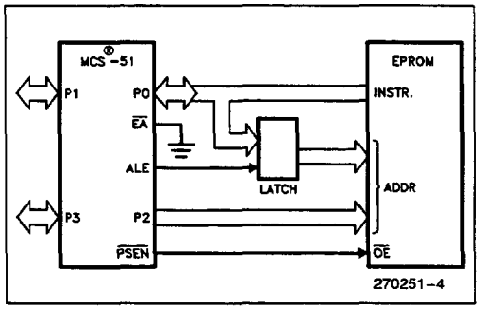
Memory Organization in 8051
Chapter 2: Microcontroller MCS51
Connect to external program memory:

Slide 14
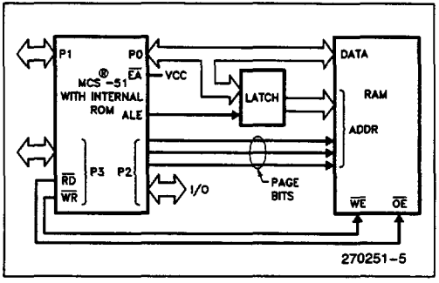
Memory Organization in 8051
Chapter 2: Microcontroller MCS51
Connect to external data memory:
2KB

Slide 15
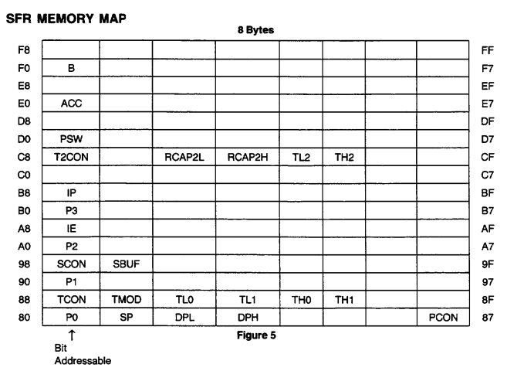
Special Function Register (SFR)
Chapter 2: Microcontroller MCS51
SFR (Special Function Register) (80H÷FFH)

Slide 16
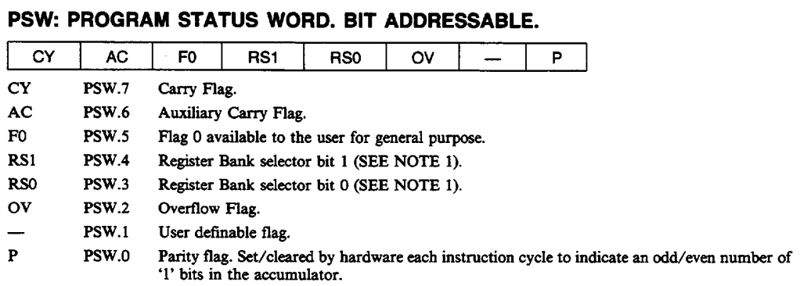
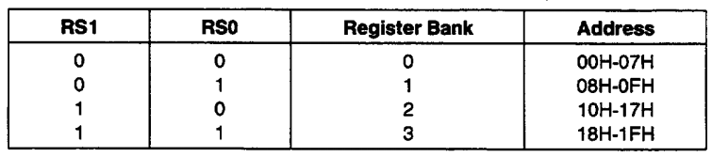
Special Function Register (SFR)
Chapter 2: Microcontroller MCS51
PSW (Progam Status Word, bit addressable)

Slide 17
Special Function Register (SFR)
Chapter 2: Microcontroller MCS51
SP (Stack Pointer):
  8-bit
  Access to stack memory
  When power-on or reset, SP is initial at value 07H

Slide 18
Special Function Register (SFR)
Chapter 2: Microcontroller MCS51
DPTR (Data Pointer):
  16 bit
  Access to external program and external Data Memory
  DPTR includes two 8-bit registers:
    DPL: lower byte of DPTR
    DPH: higher byte of DPTR

Slide 19
Special Function Register (SFR)
Chapter 2: Microcontroller MCS51
Port Registers: P0, P1, P2, P3:
  8-bit;
  Bit Addressable Register

Slide 20
Special Function Register (SFR)
Chapter 2: Microcontroller MCS51
Timer’s Registers include:
  Current value of Timer/Counter: Register pairs (TL_{i} and TH_{i}) are the 16-bit count registers for Timer/Counter 0, 1, 2 respectively
    Timer0: TH0, TL0
    Timer1: TH1, TL1
  Control and Mode Register:
    TMOD (Timer Mode, address: 89H)
    TCON (Timer Control, address: 88H): Bit Addressable

Slide 21
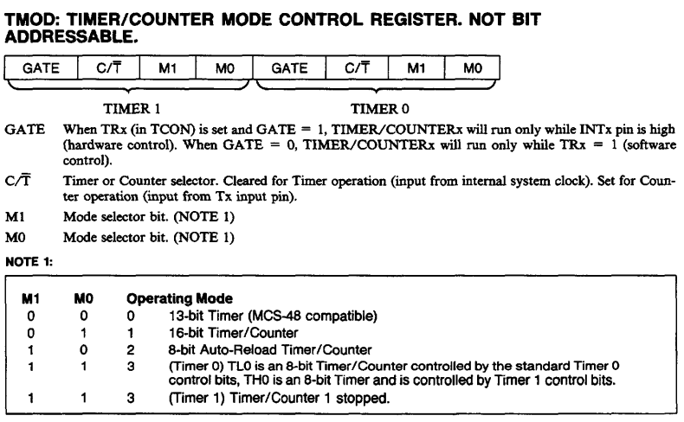
Special Function Register (SFR)
Chapter 2: Microcontroller MCS51
Timer’s Registers:
  TMOD

Slide 22
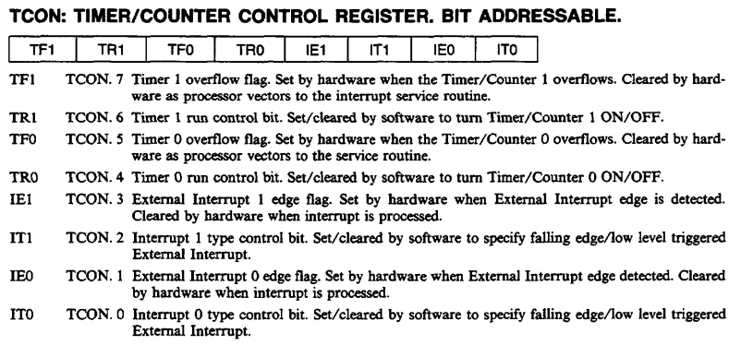
Special Function Register (SFR)
Chapter 2: Microcontroller MCS51
Timer’s Registers:
  TCON

Slide 23
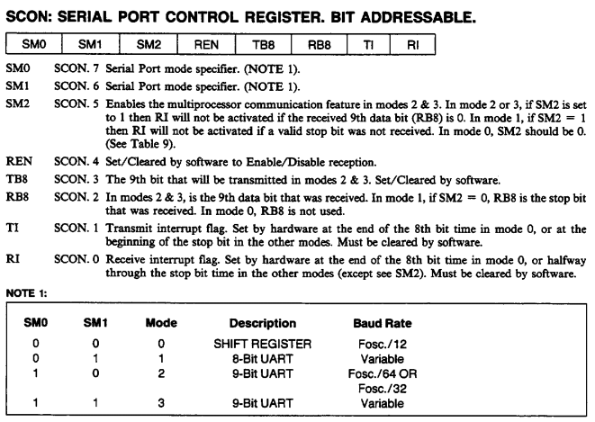
Special Function Register (SFR)
Chapter 2: Microcontroller MCS51
Serial Communication: 8051 has Serial Communication Port
  SBUF
  SCON (Serial Port Control Register): Bit Addressable

Slide 24
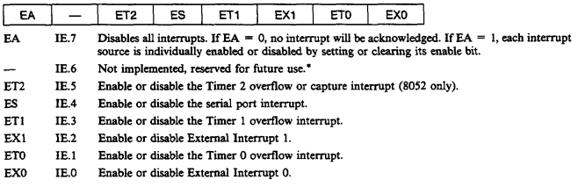
Special Function Register (SFR)
Chapter 2: Microcontroller MCS51
Interrupt Registers:
  IE (Interrupt Enable; Bit Addressable): the corresponding interrupt is enable/disable when the corresponding bit is 1/0

Slide 25
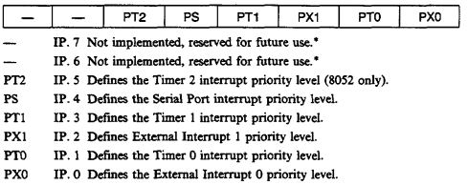
Special Function Register (SFR)
Chapter 2: Microcontroller MCS51
Interrupt Registers:
  IP (Interrupt Priority; Bit Addressable): establish the lower/higher priority among the interrupt sources when clear/set the corresponding bit

Slide 26
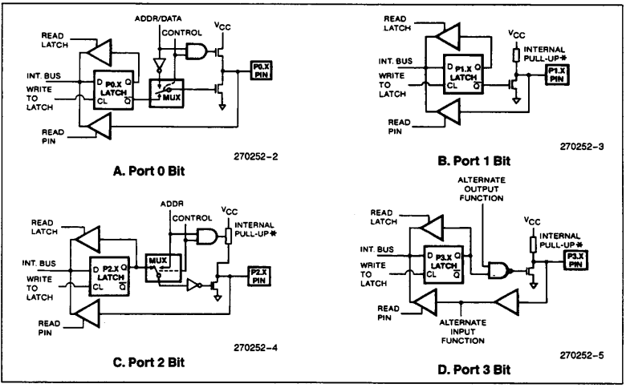
I/O Port Structure
Chapter 2: Microcontroller MCS51
8051: 4 I/O Port: P0, P1, P2, P3:
  Each Port: 8 pins
Each Pin Structure:

Slide 27
Addressing Mode
Chapter 2: Microcontroller MCS51
Including:
  Immediate Addressing
  Register Addressing
  Direct Addressing
  Register Indirect Addressing
  Indexed Addressing

Slide 28
Addressing Mode
Chapter 2: Microcontroller MCS51
Immediate Addressing:
  Source operand is constant
    Operand is following the opcode
  Move data to all registers
Register Mode
  The name of the register is one of the operands
  Notes:
    Source and Destination register must be suitable in length
Direct Addressing
  Used to access whole RAM space
    Usually for memory cells from 30H to 7FH address
    Address of memory cell is an operand of the instruction

Slide 29
Addressing Mode
Chapter 2: Microcontroller MCS51
Register Indirect Addressing:
  @R0, @R1: data in memory cell that its address is the content of R0, R1
Indexed Addressing:
  Used to access to data table in ROM or external memory

Slide 30
3.1. Introduction
Chapter 3: Assembly language in MCS-51
Machine language: include information that are presented by 0 or 1
Assembly: using mnemonic
  Mnemonic: is short name that presents opcode
Low programing language

Slide 31
3.2. Structure of Assembly instruction
Chapter 3: Assembly language MCS-51
Assembly Program: contains the sequence of assemble instructions
Common Assembly instruction structure:

Slide 32
3.3. Instruction set
Chapter 3: Assembly language in MCS-51
Arithmetic Operations: ADD, ADDC, INC, SUBB, DEC, MUL, DIV, DA,…
Logical Operations: ANL, ORL, XRL, RR, RRC, RL, RLC, CLR, CPL,…
Data Transfer: MOV, MOVX, MOVC, XCH, SWAP,…
Boolean Variable Manipulation: SETB, CLR, CPL,…
Program Branching: DJNZ, CJNE, JC, JNC, JB, JNB, JZ, JNZ, JMP,…

Slide 33
3.4. Interrupt and Programming
Chapter 3: Assembly language in MCS-51
µC 8051:
5 interrupt vector
Interrupt Sources:
When Power-on or Reset all interrupts are disabled:
  and then they are individually enabled by software.
External Interrupt 0: 0003H
Timer0 Interrupt: 000BH
External Interrupt 1: 0013H
Timer1 Interrupt: 001BH
Serial Port Interrupt: 0023H

Slide 34
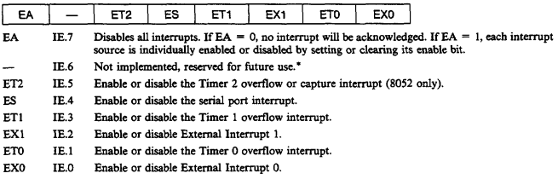
3.4. Interrupt and Programming
Chapter 3: Assembly language in MCS-51
IE (Interrupt Enable):
  Bit Addressable

Slide 35
3.4. Interrupt and Programming
Chapter 3: Assembly language in MCS-51
Default Priority (power-on/reset):
INTR0 → Timer0 → INTR1 → Timer1 → Ngắt port nối tiếp
Change Interrupt priority: access to IP (Interrupt Priority Register)

Slide 36
3.5. Interrupt and Program – External Interrupt
Chapter 3: Assembly language in MCS-51
Two causes of External Interrupt: when I/O affect to INT0 (P3.2) or INT1 (P3.3) pins:
  Low level logic on /INT0 or /INT1 pins
  Downward slope of square pulse on /INT0 hoặc /INT1 pins: edge-triggered
Mode Setting:
  ITi = 0: Low level Interrupt
  ITi = 1: Downward slope Interrupt
  Using TCON register:

Slide 37
3.6.Timer/Counter
Chapter 3: Assembly language in MCS-51

